Slide 1
DEM simulation for suction filling
Asian Pacific Congress on Computational Mechanics (APCOM)
Taipei International Convention Center, Taipei, Taiwan
20/12/2019
[MS701C] 0161
Kosei Yoshida¹ Yuki Mori¹
Kazuya Takabatake¹ Mikio Sakai^{2*}
1. Department of Nuclear Engineering and Management, School of Engineering, The University of Tokyo
2. Resilience Engineering Research Center, The University of Tokyo
Notes:
© Copyright PresentationGO.com – The free PowerPoint template library

Slide 2

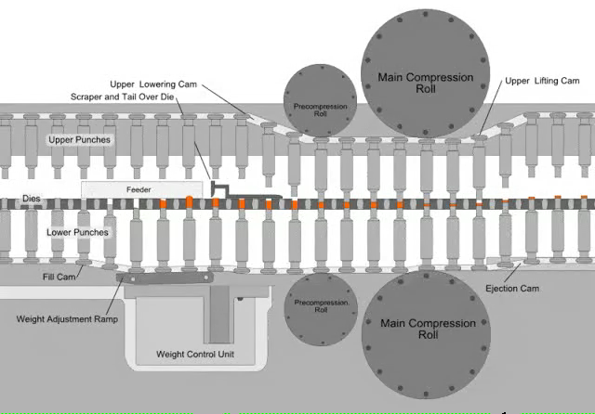
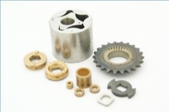
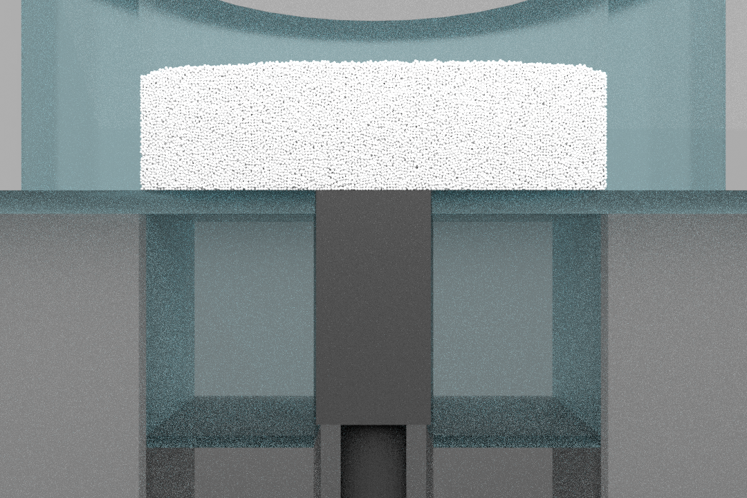
Backgrounds
Pharmaceutics
Metallurgy
Ceramics
・Powder compaction process
Powder compaction is widely used manufacturing process in above industries.
This process consists of 3 phases
➀ Die filling
➁ Pressing
➂ Ejection
Important for productivity
・Suction effect
The phenomenon that powder is drawn into the die region by the downwards motion of punch.
・Previous Research
The effectiveness of suction effect has been examined mostly by the experiment.^{[1]}
[1] S. Jackson, I.C. Sinka, A.C.F. Cocks, 2006

Slide 3
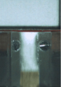
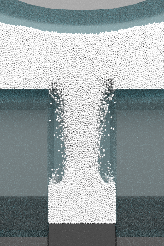
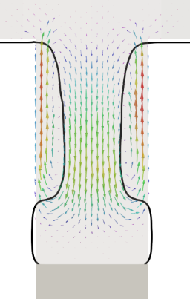
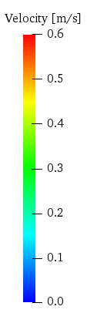
Objective
Problem
Only by employing experiment, it’s difficult to obtain data inside of the die region.
Experiment
Numerical Simulation
1. Can’t pause powder flow
2. Difficult setting sensors
3. Difficult making certain experimental conditions
1. Can watch every moments
2. Can get many kinds of data
e.g.
・Pressure distribution
・Velocity distribution
3. Can make any conditions
Objective
To reveal the mechanism of the suction effect in the die filling by employing numerical simulation.

Slide 4
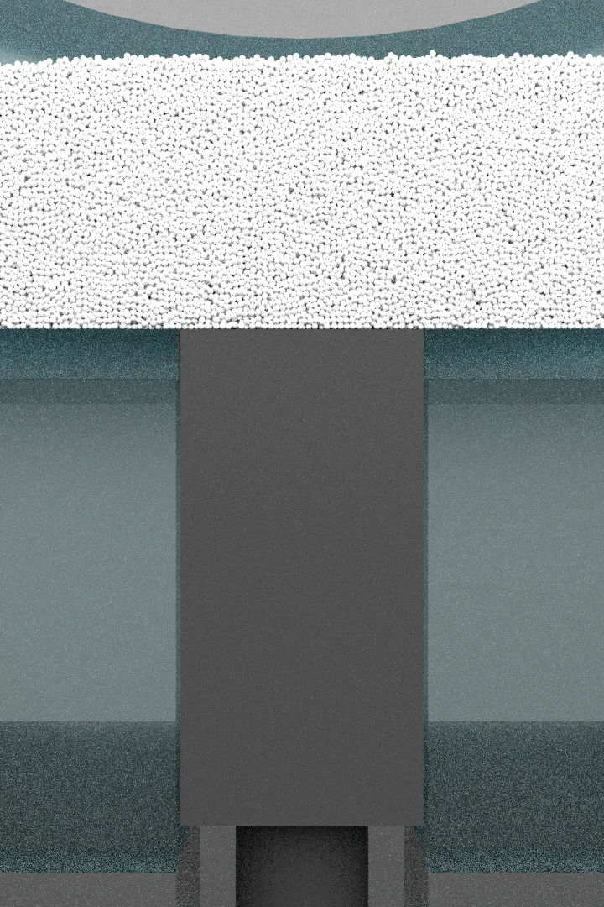
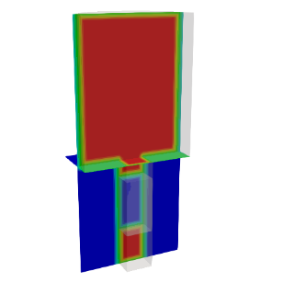
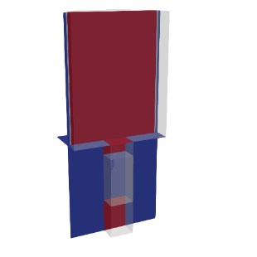
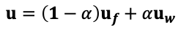
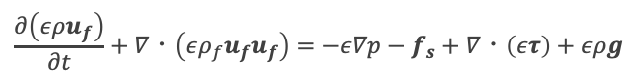
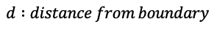
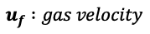
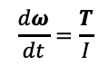
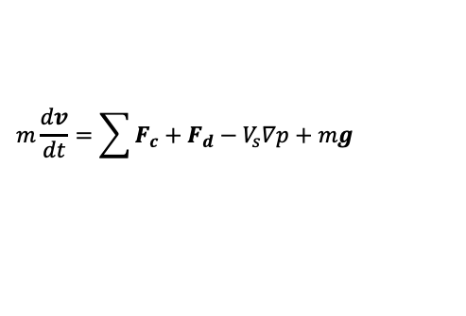
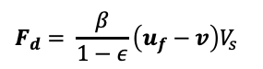
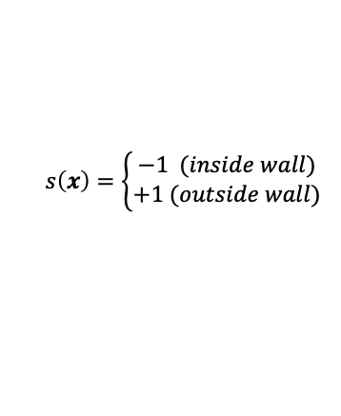
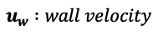
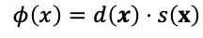
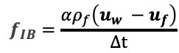
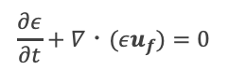
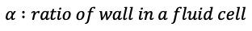
Numerical Methods
Problem
Modeling of moving boundary with low calculation cost had been difficult.
Advanced DEM–CFD Method^{[1]}
DEM-CFD Method^{[2]}
Solid phase：Discrete Element Method^{[3]}
Gas phase：Computational Fluid Dynamics
(Local volume averaged)
$$m\frac{dv}{dt}=\sum{F_{c}}+F_{d}−V_{s}∇p+mg$$
$$\frac{∂\left(ερu_{f}\right)}{∂t}+∇・\left(ερ_{f}u_{f}u_{f}\right)=−ε∇p−f_{s}+∇・\left(ετ\right)+ερg$$
$$\frac{dω}{dt}=\frac{T}{I}$$
$$F_{d}= \frac{β}{1−ε}\left(u_{f}−v\right)V_{s}$$
$$\frac{∂ε}{∂t}+∇・(εu_{f})=0$$
Drag force
Boundary conditions
Solid phase：Signed Distance Function^{[4]}
Gas phase : Immersed Boundary Method^{[5]}
$$u=\left(1−α\right)u_{f}+αu_{w}$$
$$φ\left(x\right)=d\left(x\right)⋅s\left(x\right)$$
$$s\left(x\right)=\left\{\begin{aligned}−1 (inside wall) \\ +1 (outside wall)\end{aligned}\right.$$
$$f_{IB}=\frac{αρ_{f}\left(u_{w} −u_{f}\right)}{Δt}$$
$$d :distance from boundary$$
$$α :ratio of wall in a fluid cell$$
$$u_{w} :wall velocity$$
$$u_{f} :gas velocity$$
[1] H. Yao, et al., 2018
[2] Y. Tsuji et al., 1993
[3] P. Cundall et al., 1979
[4] Y. Shigeto et al., 2013
[5] Sun X., et al., 2017
Notes:
Newton’s second law of motion.

Slide 5
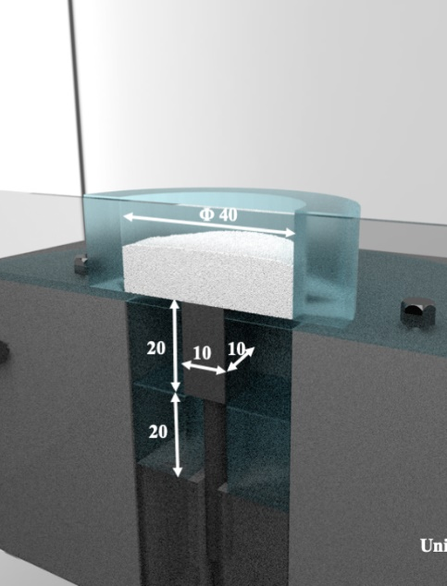
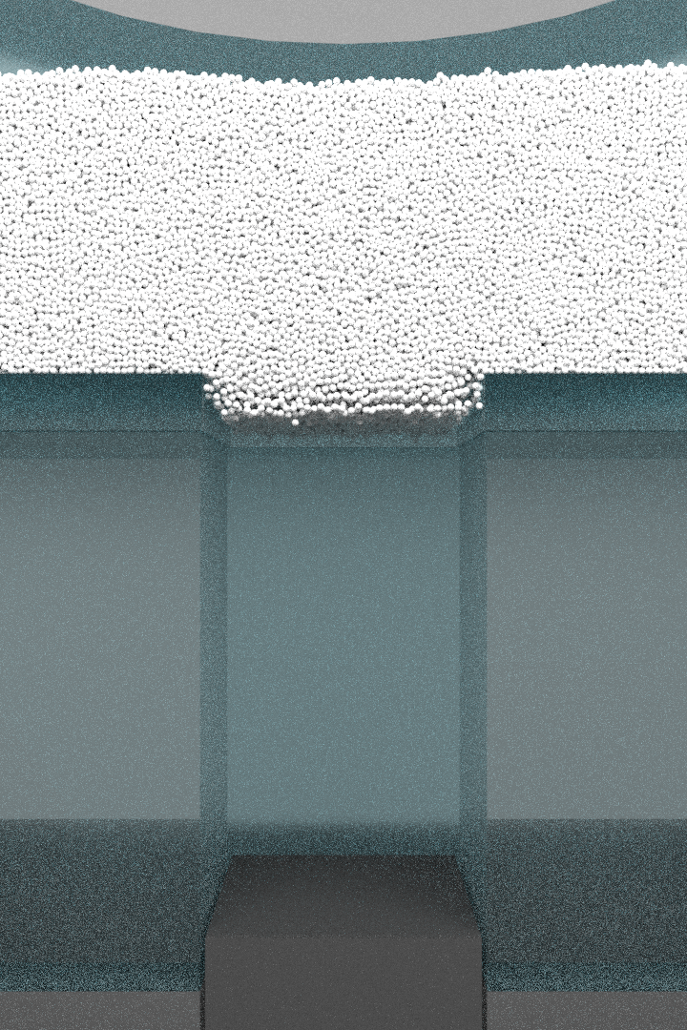
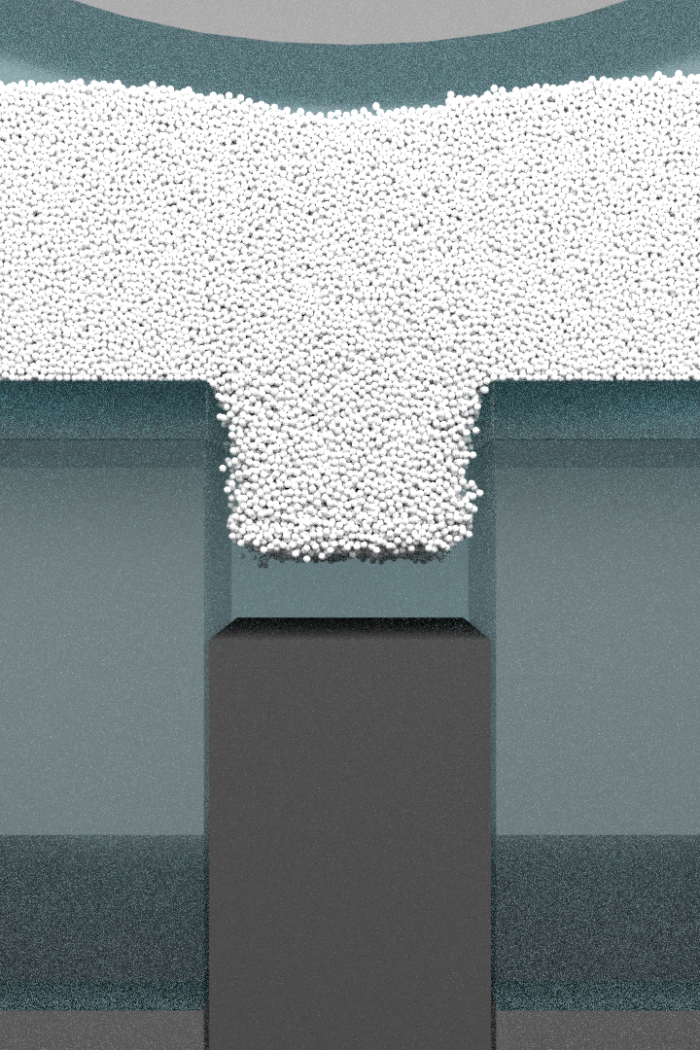
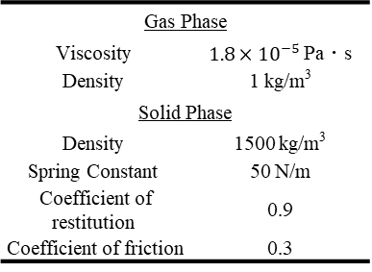
Conditions
Compare gravity filling with suction filling
Punch stays
at the bottom
Punch moves downwards
(500 mm/s)
Gravity filling
Suction filling
Physical properties
Calculation conditions
Gas Phase
Viscosity | $1.8×{10}^{−5}$ Pa・s
Density | 1 kg/m³
Solid Phase
Density | 1500 kg/m³
Spring Constant | 50 N/m
Coefficient of restitution | 0.9
Coefficient of friction | 0.3
Diameter | 250 μm
Number of particles | 500,000
System | Mono-dispersed
Grid size | 0.5 mm
Calculation time | 0.24 s
Time step | 2.0 × 10⁻⁶ s
Unit : mm

Slide 6
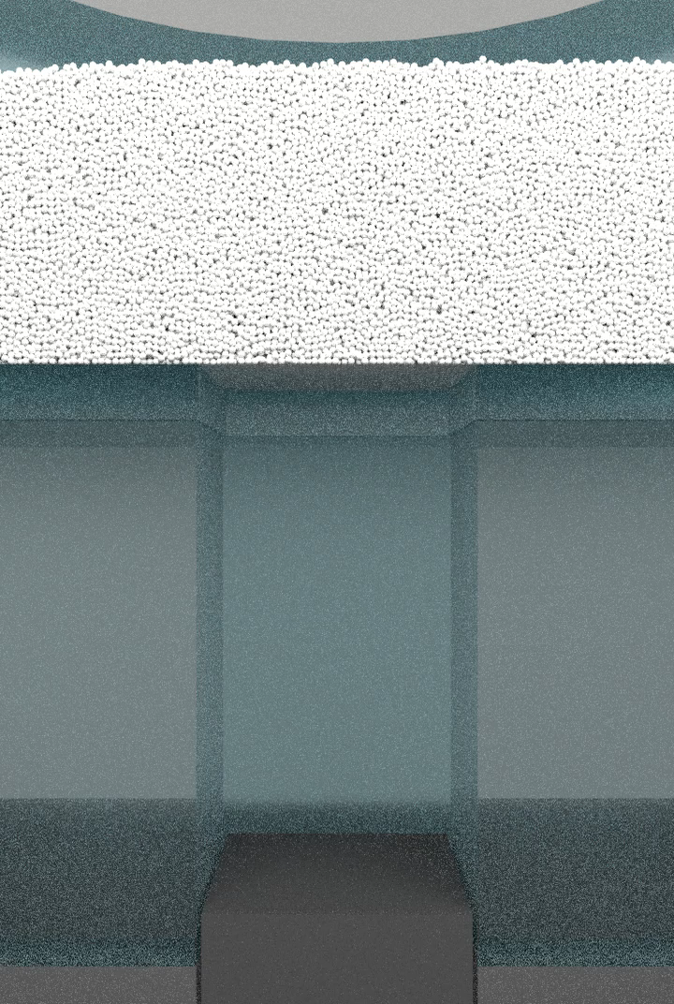
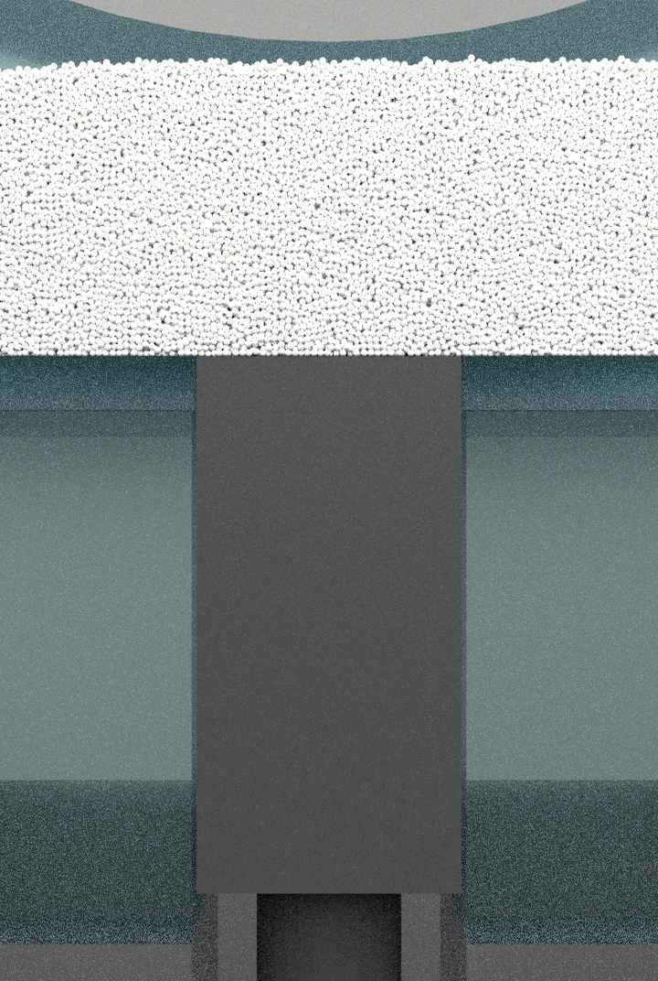
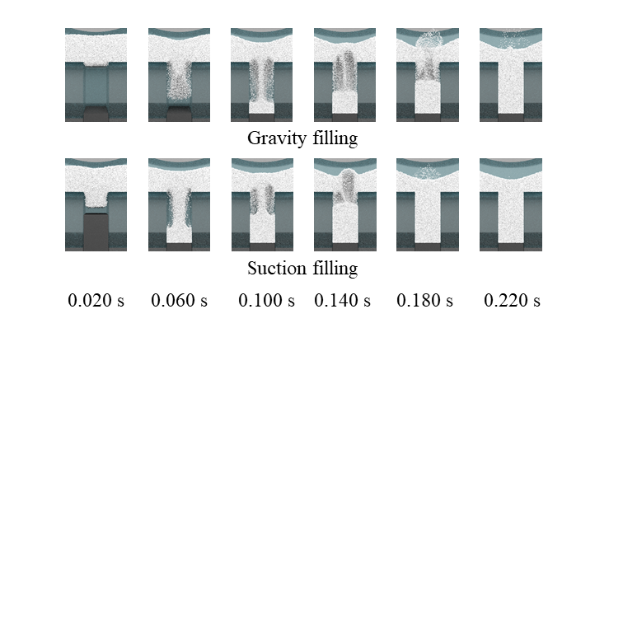
Results & Discussion
Gravity filling
Suction filling
In case suction filling,
0.020 s – much powder fed into the die region
0.060 s – powder concentrated along the center axis of die region and made much denser flow
0.180 s – completion of powder filling was earlier

Slide 7

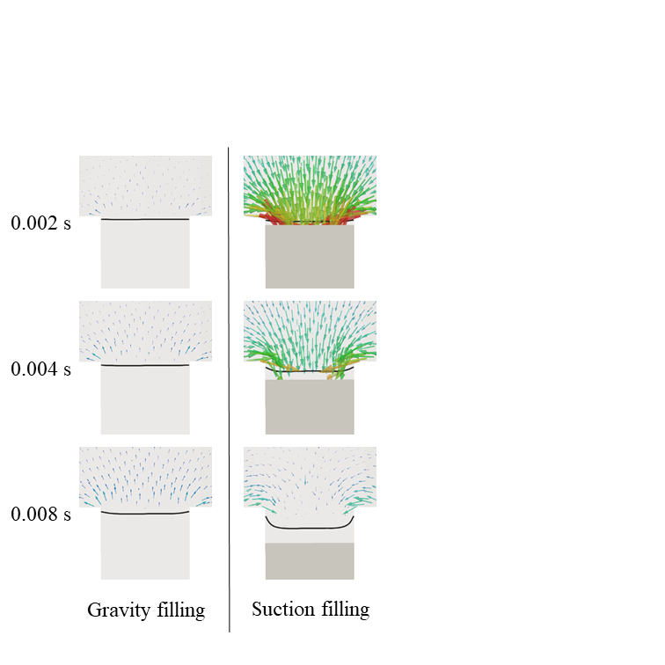
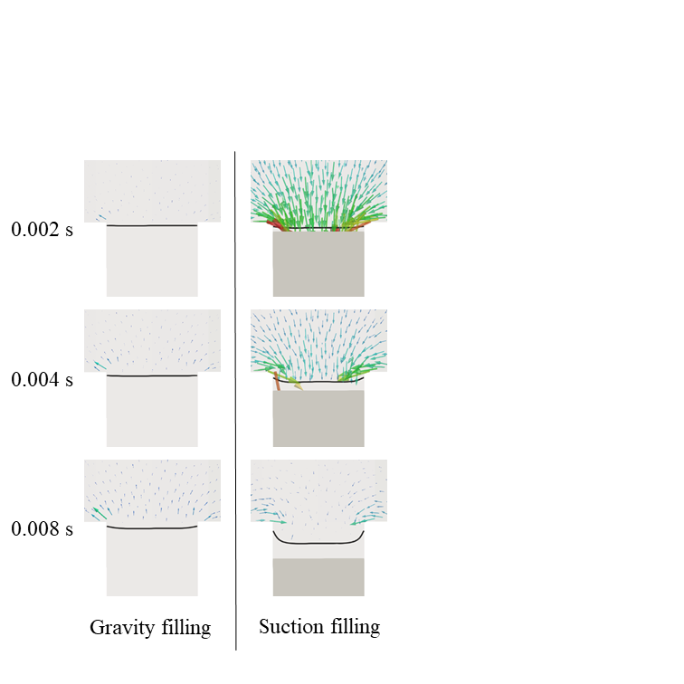
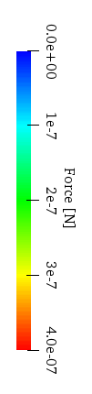
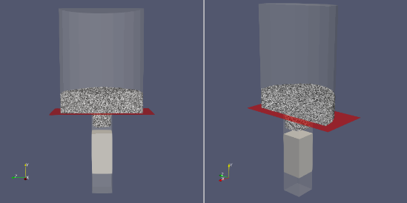
Results & Discussion
Pressure gradient
Drag
・Suction effect was produced by the pressure and drag force acted on powder
Powder flux transition
Originality
Influence of drag force is firstly found through this research.
Notes:
I‘d like to emphasize

Slide 8
Results & Discussion
Does the filling completion time becomes shorter as the punch velocity is higher ?
Consider only the influence of pressure gradient and drag force
Natural phenomenon
: has local minimum value
Powder flux transition
Powder filling time
The natural phenomenon (the existence of the local minimum value) can’t be explained only by the influence of the pressure gradient and drag force.
Other factors which influence to the powder filling time exist.
Conditions
Compare the 6 cases of the downward speed of punch. 200, 300, … , 700 mm/s . (6 cases)

Slide 9
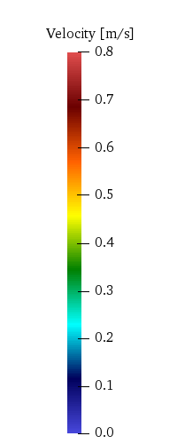
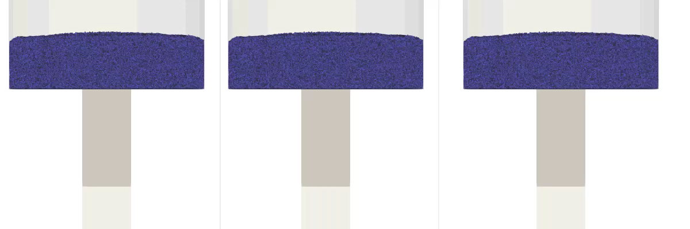
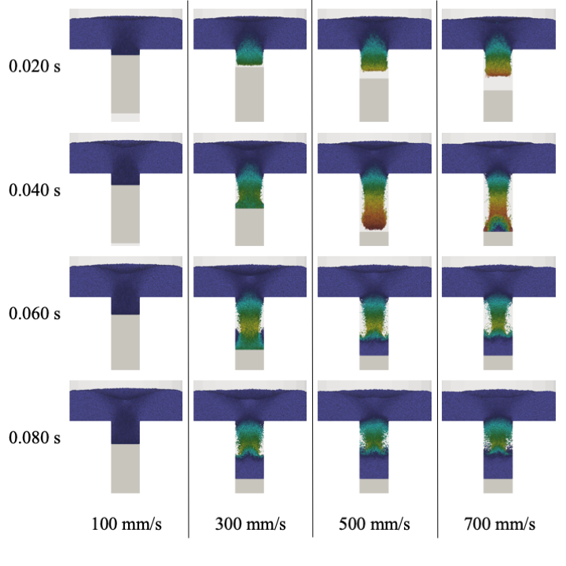
Results & Discussion
300 mm/s
500 mm/s
700 mm/s
The existence of the local minimum value was observed in the simulation.
0.040 s - much powder fed into the die region in the case of 500 & 700 mm/s
0.080 s - no clear difference of the powder filling rate among the 3 cases.

Slide 10
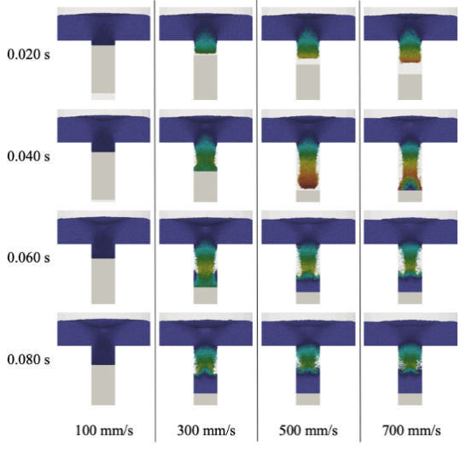

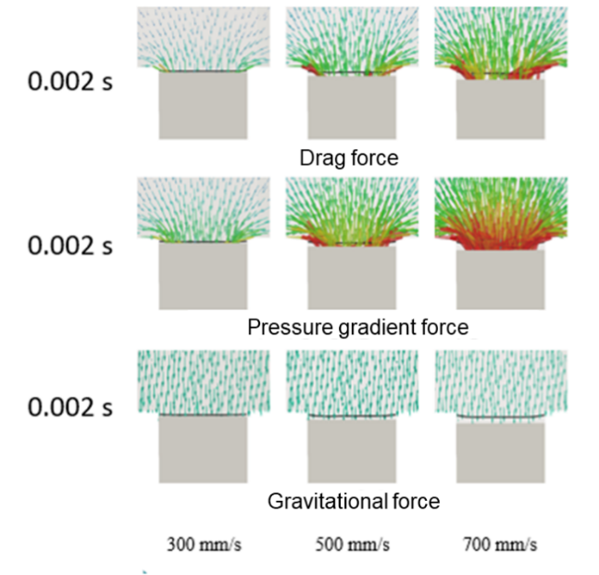
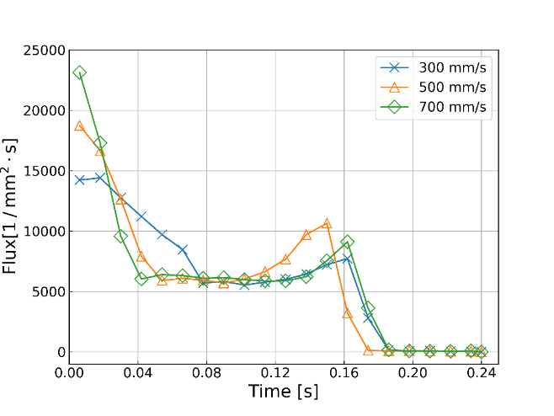
Results & Discussion
①
②
① High flux in the initial stage
As the punch speed was higher, the pressure gradient and drag force were stronger. And it created high flux in the initial stage.
② Flux increase at the final stage
The times of flux increase end were different in each cases. The case 500 mm/s was the earliest.
The earliness of ➁ was correspond to the shortness of the filling completion time

Slide 11
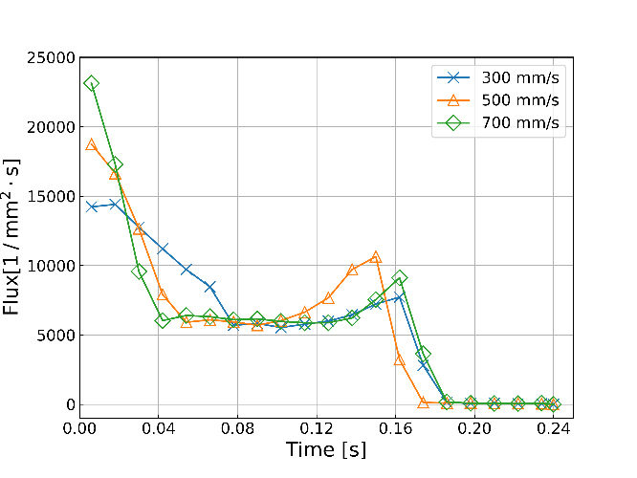
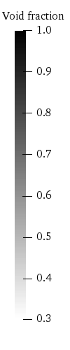
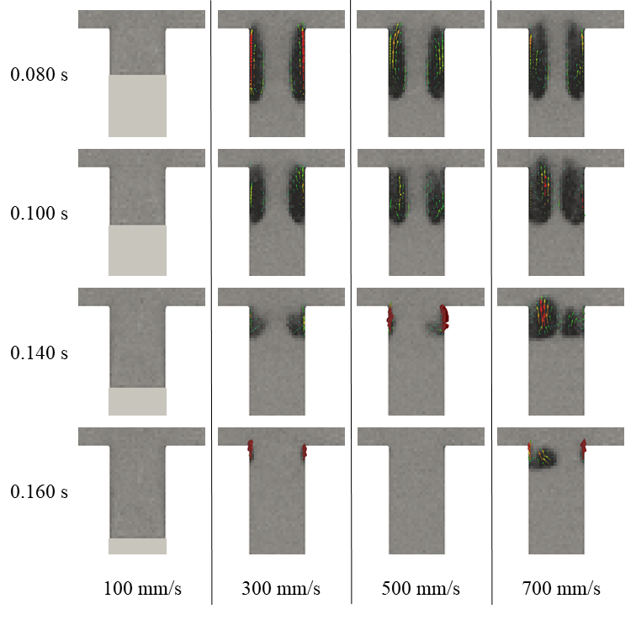
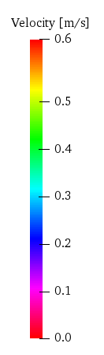
Results & Discussion
② Flux increase at the final stage
Bubbles prevented the powder flow into the die region
After bubbles came out,
powder filled the die completely
Bubbles in the die
Originality
When punch speed is too high, bubble prevents the powder flux

Slide 12


Conclusions
Revealed the mechanism of suction effect in the die filling.
1. Suction effect is produced
by drag force and pressure gradient
In the moment of the punch start moving, both pressure gradient force and drag force act on powder. And they accelerates the powder.
Pressure
Drag
2. When punch speed is too high,
bubble prevent the powder flux
Punch movement suctions air into the die region, not only powder. It makes bubbles which prevent the powder feed into the die and delays the powder filling time.

Slide 13
DEM simulation for suction filling
Asian Pacific Congress on Computational Mechanics (APCOM)
Taipei International Convention Center, Taipei, Taiwan
20/12/2019
[MS701C] 0161
Kosei Yoshida¹ Yuki Mori¹
Kazuya Takabatake¹ Mikio Sakai^{2*}
1. Department of Nuclear Engineering and Management, School of Engineering, The University of Tokyo
2. Resilience Engineering Research Center, The University of Tokyo
Notes:
© Copyright PresentationGO.com – The free PowerPoint template library

Slide 14
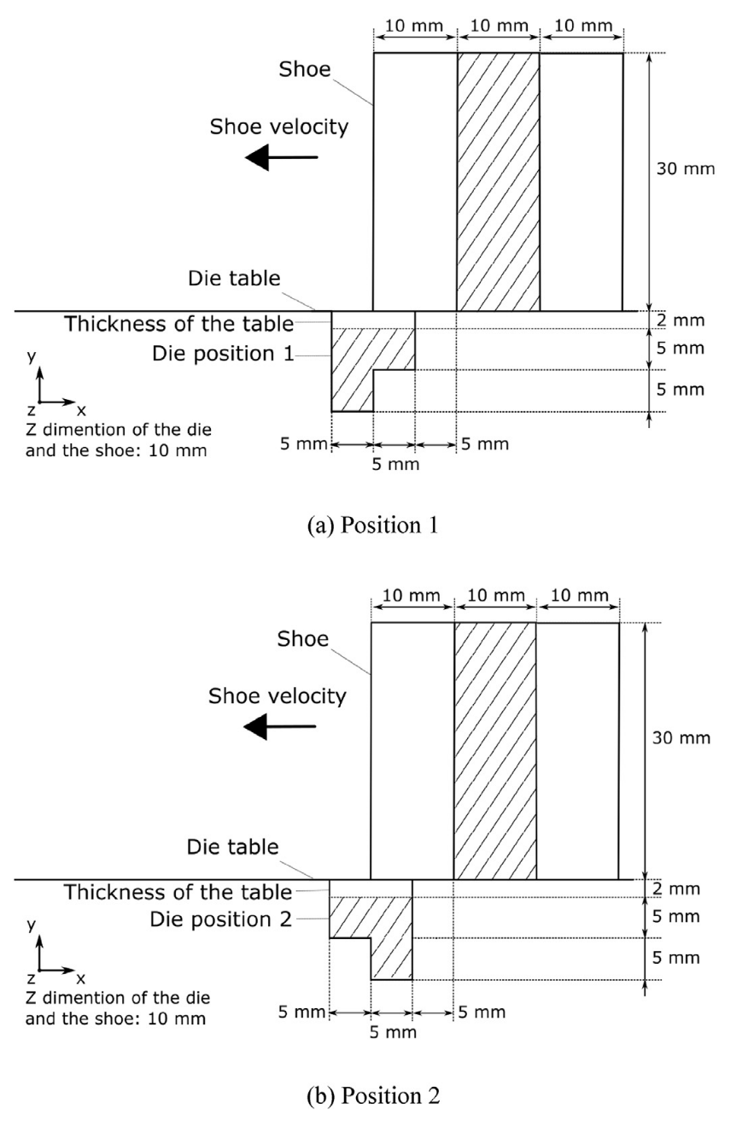
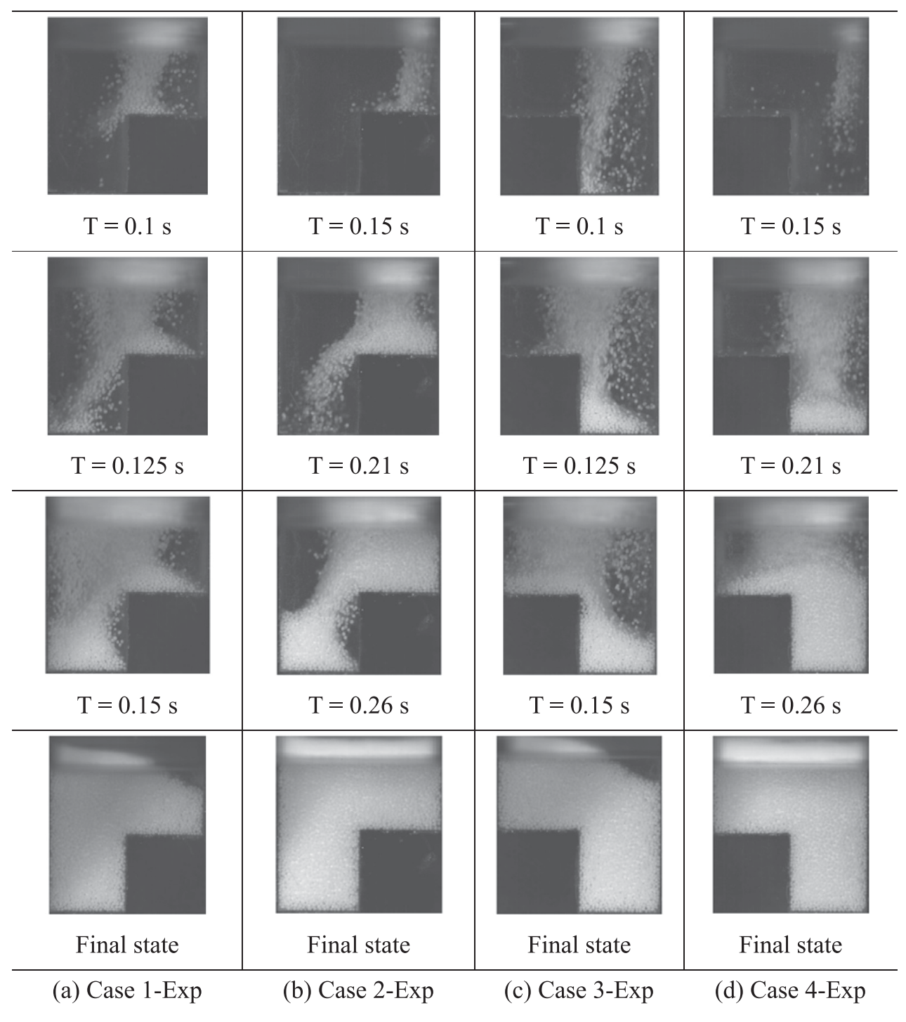
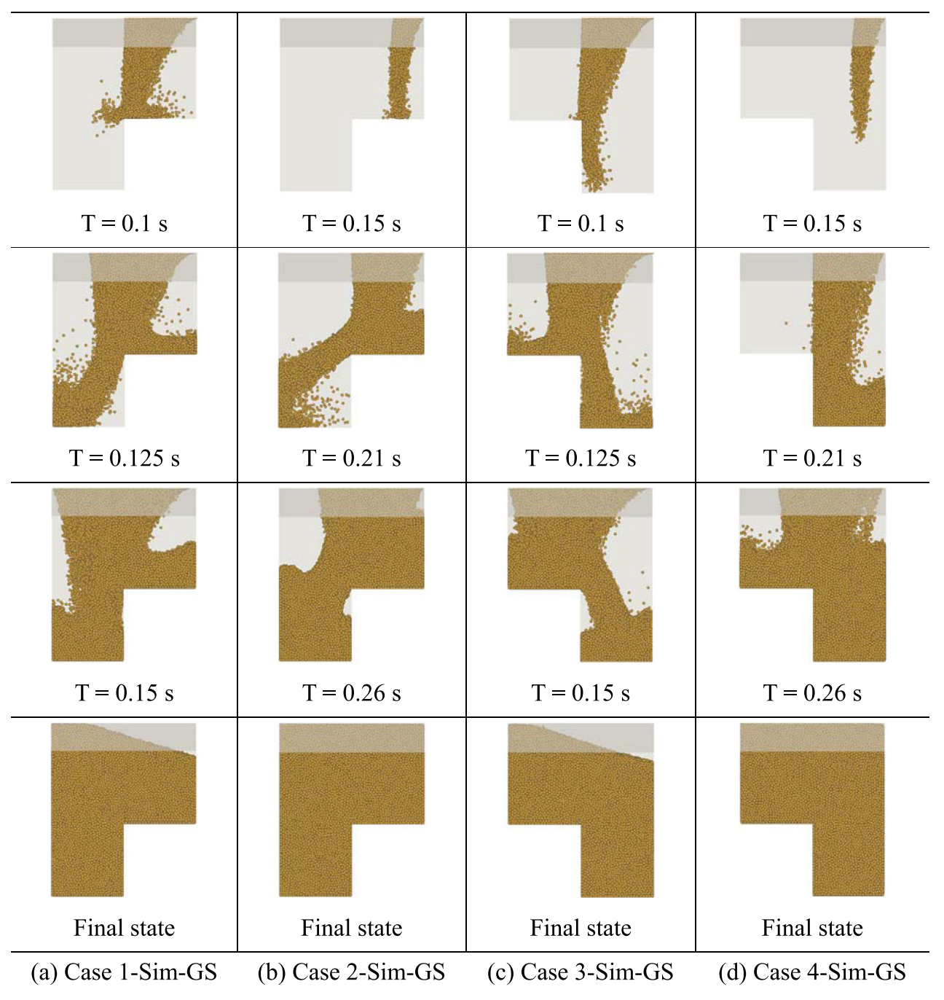
Validation of the method
Advanced DEM–CFD Method was validated in moving boundary system.^{[1]}
Powder flow shape was correspond.
Final filled shape was also correspond.
Boundary conditions
Solid phase：Signed Distance Function^{[3]}
Gas phase : Immersed Boundary Method^{[4]}
$$u=\left(1−α\right)u_{f}+αu_{w}$$
$$φ\left(x\right)=d\left(x\right)⋅s\left(x\right)$$
$$s\left(x\right)=\left\{\begin{aligned}−1 (inside wall) \\ +1 (outside wall)\end{aligned}\right.$$
$$f_{IB}=\frac{αρ_{f}\left(u_{w} −u_{f}\right)}{Δt}$$
$$d :distance from boundary$$
$$α :ratio of wall in a fluid cell$$
$$u_{w} :wall velocity$$
$$u_{f} :gas velocity$$
[1] H. Yao, et al., 2018

